Slide 1
Suggested Project Topics
Zonghua Gu

Slide 2
General Comments
Each project group should consist of 1-2 students
I found that large teams often result in freeloaders that don’t contribute.
These are suggested topics; you are free to propose your own topic, as long as I approve them
Multiple groups can choose the same general topic, but the specific work details must be different
All references listed here can be obtained with a quick web search. If you cannot find any of them, ask me and I will send to you.
Email discussions are welcome. If more intensive interaction is needed, you can add my QQ: 59331972
A 1-2 page proposal is due on Oct 24 (Wed) in class; I will give you feedback.

Slide 3
Comparison of User-Space Scheduling Packages
When testing a new scheduling algorithm, one generally needs to modify the Linux kernel, which is error prone
Some authors have shown that you can implement various scheduling algorithms with a user-space scheduling library → No kernel hacking required!
M. Mollison and J. Anderson, "Bringing Theory into Practice: A Userspace Library for Multicore Real-Time Scheduling", in submission. PDF.
http://www.cs.unc.edu/~mollison/userspace-library/index.html
Shinpei Kato, Ragunathan (Raj) Rajkumar, and Yutaka Ishikawa, A Loadable Real-Time Scheduler Framework for Multicore Platforms, RTCSA 2010
http://www.contrib.andrew.cmu.edu/~shinpei/papers/rtcsa10.pdf
http://www.contrib.andrew.cmu.edu/~shinpei/download/resch-1.0.0.tar.gz
Mikael Asberg, Thomas Nolte, Shinpei Kato, Ragunathan Rajkumar: ExSched: An External CPU Scheduler Framework for Real-Time Systems. RTCSA 2012: 240-249
http://ertl.jp/~shinpei/papers/rtcsa12.pdf
No source code online, but you can perhaps request it from the authors.
Fabio Falzoi, Juri Lelli, Giuseppe Lipari, PRACTISE: a framework for PeRformance Analysis and Testing of real-time multIcore SchEdulers for the Linux kernel, OSPERT 2012
https://github.com/Pippolo84/PRAcTISE
Your task: download and run these SW packages on Linux, and compare their performance and expressive power.

Slide 4
RT-Scheduling Simulators
Download an open-source RT scheduling simulator, e.g.
https://code.google.com/p/schesim/
http://rtsim.sssup.it/
and implement some advanced RT scheduling algorithms, e.g.,
Mixed-Criticality Scheduling
http://adsig.embedded-systems-portal.org/education/course-materials/artist-international-summer-schools/ search for “Baruah”
Preemption threshold scheduling
http://www.embedded.com/design/operating-systems/4213728/How-PTS-benefits-embedded-systems-designs
Notes:
e.g., resource reservation algorithms like
Constant Bandwidth Server for EDF,
Polling Server, Deferrable Server for Fixed-Priority
http://code.google.com/p/hssim/
For more details, refer to my Real-Time course homepage or come talk to me
http://www.cs.zju.edu.cn/people/zgu/RT/

Slide 5
RT Scheduling Algorithms in TrueTime
TrueTime is a Simulink toolbox for integrated simulation of CPU/network scheduling and continuous plant dynamics
http://www.control.lth.se/truetime/
It currently supports
Network block (Ethernet, CAN, TDMA, FDMA, Round Robin, Switched Ethernet, FlexRay and PROFINET)
Wireless network block (802.11b WLAN and 802.15.4 ZigBee)
Battery-powered devices, Dynamic Voltage Scaling
Implement more recent CPU/Network scheduling algorithms within TrueTime.

Slide 6
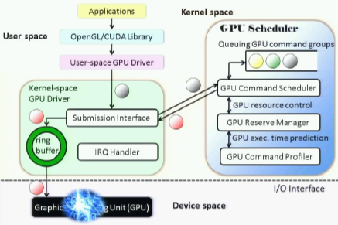
Real-Time GPU Scheduling
Conventional GPU adopts FIFO task scheduling, not a RT scheduling algorithm.
TimeGraph: implement priority queuing & resource reservation on CPU in Linux kernel
http://rtml.ece.cmu.edu/projects/timegraph/
System Software Support for GPU-accelerated Applications, talk at Microsoft, 2010
http://research.microsoft.com/apps/video/default.aspx?id=141120&l=i
Can Basaran and Kyoung-Don Kang, Supporting Preemptive Task Executions and Memory Copies in GPGPUs, ECRTS 2012
http://ecrts.eit.uni-kl.de/fileadmin/user_media/ecrts12/91.pdf
Your task: implement (download if available) and compare different RT scheduling algorithms for GPUs in Linux env..

Slide 7
RT Interrupt Handling in RT Linux
Recent study shows that assigning the highest fixed-priority to interrupt handler is not a good approach for many applications
Glenn A. Elliott and James H. Anderson, The Limitations of Fixed-Priority Interrupt Handling in PREEMPT RT and Alternative Approaches, RTLinux Workshop 2012
http://www.cs.unc.edu/~anderson/papers/rtlws12.pdf
The paper mentioned several alternative techniques that dynamically adjusts interrupt handler priority. Implement and evaluate these techniques in Linux kernel, especially in the context of GPU interrupt handling
Glenn A. Elliott, Chih-Hao Sun, and James H. Anderson, Real-Time Handling of GPU Interrupts in LITMUS-RT, 2011
http://www.cs.unc.edu/techreports/11-002.pdf
Glenn A. Elliott, James H. Anderson: Robust Real-Time Multiprocessor Interrupt Handling Motivated by GPUs. ECRTS 2012: 267-276
PPT: http://ecrts.eit.uni-kl.de/fileadmin/user_media/ecrts12/27.pdf
Source code may be available at http://www.litmus-rt.org/

Slide 8
Control Flow Integrity (CFI) Algorithms
Program control flow can be compromised due to malicious attacks or hardware soft errors
Control flow
Many CFI techniques have been proposed to ensure runtime control flow correctness; Implement one or more of these techniques, and evaluate their RT performance:
李爱国, 洪炳镕, 王司,软件实现的程序控制流校验方法研究进展, 2008
吴艳霞, 顾国昌, 付岩, 程立新,并发控制流检测技术综述, 2007
Martín Abadi, Mihai Budiu, Úlfar Erlingsson, Jay Ligatti: Control-flow integrity principles, implementations, and applications. ACM Trans. Inf. Syst. Secur. 13(1): (2009)

Slide 9
Use of Scripting Languages in RT Systems
Scripting languages like JavaScript, Python, Ruby, Lua, etc. are very useful, but can they be used in a hard RT environment?
Will garbage collection affect RT performance?
Some authors addressed this issue for Lua
Markus Klotzbuecher, et al, Hard real-time Control and Coordination of Robot Tasks using Lua, Real-Time Linux Workshop 2011.
Run performance experiments using a scripting language, and if possible, propose improvements to ensure real-time performance.

Slide 10
UPPAAL-based Static Scheduling
UPPAAL is a formal verification tool based on Timed Automata (http://www.uppaal.org/).
Static cyclic scheduling is a common scheduling method for safety-critical avionics applications.
UPPAAL can be used to find the optimal schedule by checking reachability of the final state (all tasks finished) from the initial state (all tasks not started) and finding the shortest path.
Yasmina Abdeddaïm, Oded Maler: Preemptive Job-Shop Scheduling Using Stopwatch Automata. TACAS 2002: 113-126
Implement UPPAAL models for optimal static cyclic scheduling on multicore processors.
I have a preliminary model available upon request.

Slide 11
UPPAAL-TIGA for Scheduling w/ Uncertainties
UPPAAL-TIGA is a model-checker for two-player games
Download: http://people.cs.aau.dk/~adavid/tiga/
Quick tutorial: http://www.ulb.ac.be/di/verif/ggeeraer/SysEmb/TPUppaal.pdf
It can be used to handle RT scheduling problems with uncertainty
Uncertain execution times, e.g., exec time in the interval [4, 7] instead of a fixed number
Uncertain runtime control flow, e.g., if-then-else statements
It’s a game between the environment and the scheduler: env. chooses an exec time or control flow decision, and scheduler must react to handle it by making runtime decisions, i.e., the schedule is not fully static, but runtime adaptive.
Implement some examples in this paper
Yasmina Abdeddaïm, Eugene Asarin, Oded Maler: Scheduling with timed automata. Theor. Comput. Sci. 354(2): 272-300 (2006)

Slide 12
Model-Checking for WCET Analysis
WCET (Worst-Case Execution Time) analysis is for determining the longest execution time of a piece of code. The conventional approach to WCET analysis is based on ILP (Integer Linear Programming)
A number of authors have developed techniques for WCET analysis based on model-checkers UPPAAL or SPIN
Christian Frost, et al, WCET Analysis of Java Bytecode Featuring Common Execution Environments, 2011
http://projekter.aau.dk/projekter/files/52817930/FINAL_PRINT.pdf
McAiT --- A Timing Analyzer for Multicore Real-Time Software
http://www.neu-rtes.org/mcait/
METAMOC
http://metamoc.martintoft.dk
LAN WU and WEI ZHANG, A Model Checking Based Approach to Bounding Worst-Case Execution Time for Multicore Processors, TECS 2012. (Uses the SPIN model-checker http://spinroot.com/)
Implement (or download if available) these techniques, and compare their accuracy and scalability with conventional WCET analyzers.

Slide 13
WCET Analysis for OS Code (SELinux/SEAndroid)
RTOS code brings unique challenges to WCET analysis.
Daniel Sandell, Andreas Ermedahl, Jan Gustafsson, Björn Lisper: Static Timing Analysis of Real-Time Operating System Code. ISoLA 2004: 146-160
Mingsong Lv, Nan Guan, Yi Zhang, Qingxu Deng, Ge Yu, Jianming Zhang: A Survey of WCET Analysis of Real-Time Operating Systems. ICESS 2009: 65-72
PPT: http://www.neu-rtes.org/publications/lv_ICESS09ppt.pdf
Showed an average of 86% overestimation compared to application programs
Mingsong Lv, et al, Static worst-case execution time analysis of the μC/OS-II real-time kernel, Front. Comput. Sci. China 2010, 4(1): 17–27
http://www.neu-rtes.org/publications/Lv_FCS10.pdf
Bernard Blackham, Yao Shi, Sudipta Chattopadhyay, Abhik Roychoudhury, and Gernot Heiser. Timing analysis of a protected operating system kernel. In 32nd RTSS, Vienna, Austria, Nov 2011.
http://www.comp.nus.edu.sg/~sudiptac/papers/rtss11.pdf
SELinux/SEAndroid enhance Linux/Android with security mechanisms (access control). But how do these mechanisms affect RT performance?
Use a WCET analysis tool to analyze an open-source SELinux or SEAndroid implementation, and compare to regular Linux/Android.

Slide 14
LLVM as Frontend for WCET Analysis
LLVM (http://llvm.org/) is a widely-used compiler infrastructure framework.
Many WCET analysis tools use different compiler frontends.
Some authors proposed to use LLVM as the unified compiler frontend
Benedikt Huber, Wolfgang Puffitsch, Peter Puschner, Towards an Open Timing Analysis Platform, WCET Workshop 2011
Implement file format conversion tools to connect LLVM output to input of one of the WCET analysis tools (aiT, SWEET, OTTAWA, Chronos, etc.)

Slide 15
Modeling of Non-Volatile Memory Systems (NVM) within GEM5
NVM refers to many novel emerging memory technologies that have the potential to replace conventional DRAM as main memory or cache
PCM (Phase-Change Memory), M-RAM, R-RAM…
GEM5 (http://www.m5sim.org/) is an architectural simulator that can simulate CPU, GPU, memory, bus, etc.
Implement modules within GEM5 to simulate one or more types of NVM, especially, PCM.
Ping Zhou, TOWARDS SUCCESSFUL APPLICATION OF PHASE CHANGE MEMORIES: ADDRESSING CHALLENGES FROM WRITE OPERATIONS, PhD Thesis 2011 (he used SIMICS+GEMS, but you should use GEM5)
http://d-scholarship.pitt.edu/10870/

Slide 16
Instrumentation and Fault Injection of AUTOSAR OS
AUTOSAR OS is a RTOS standard in automotive industry. The following papers describe instrumentation and fault injection techniques for AUTOSAR OS, at either source code or binary code level. You can choose to implement one or more of these techniques, based on open-source AUTOSAR OS Arctic Core (www.arccore.com).
Thorsten Piper, Stefan Winter, Paul Manns, Neeraj Suri: Instrumenting AUTOSAR for dependability assessment: A guidance framework. DSN 2012: 1-12
C. Lu, J.-C. Fabre, and M.-O. Killijian, “An approach for improving Fault-Tolerance in Automotive Modular Embedded Software,” in Proc. of the 17th International Conference on Real-Time and Network Systems (RTNS), 2009.
C. Lu, J.-C. Fabre, and M.-O. Killijian, “Robustness of modular multilayered software in the automotive domain: a wrapping-based approach,” in Proc. of the 14th IEEE International Conference on Emerging Technologies & Factory Automation, 2009, pp. 1102–1109.
Your implementation can be in a simulation environment, no need for a HW board.

Slide 17
Fault Injection within CANoe
CANoe is a network and system-level simulator for distributed automotive control systems
Supports multiple bus protocol standards, including CAN, LIN, FlexRay, etc.
Implement the network fault injection tool within CANoe described in
Patrick E. Lanigan, Priya Narasimhan, Thomas E. Fuhrman: Experiences with a CANoe-based fault injection framework for AUTOSAR. DSN 2010: 569-574
http://users.ece.cmu.edu/~planigan/research/lanigan-dsn10.key.pdf
http://users.ece.cmu.edu/~planigan/research/lanigan-dsn10.pdf
CANoe evaluation software can be downloaded from http://www.vector.com

Slide 18
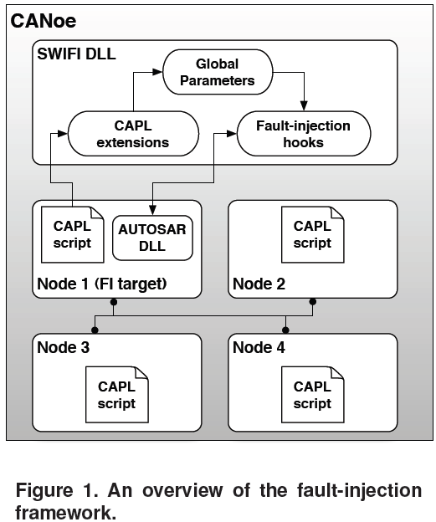
Since we do not have access to their AUTOSAR OS, we cannot implement OS fault injection in this work.
We can only inject network faults, e.g., lost packets.

Slide 19
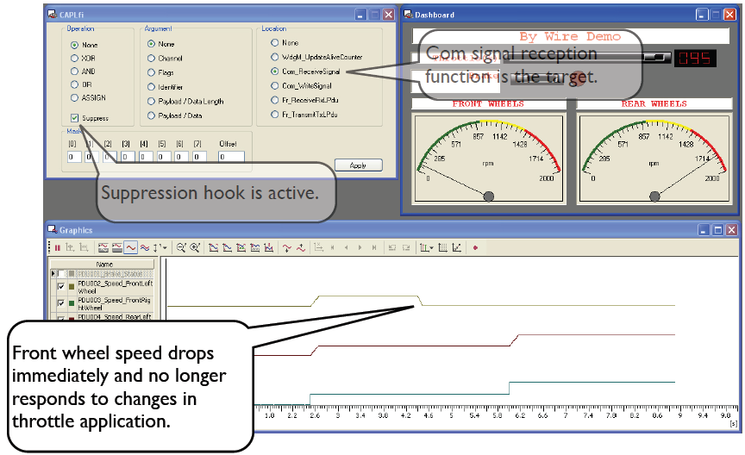
Use the GUI to inject various faults in CANoe

